Slide 1
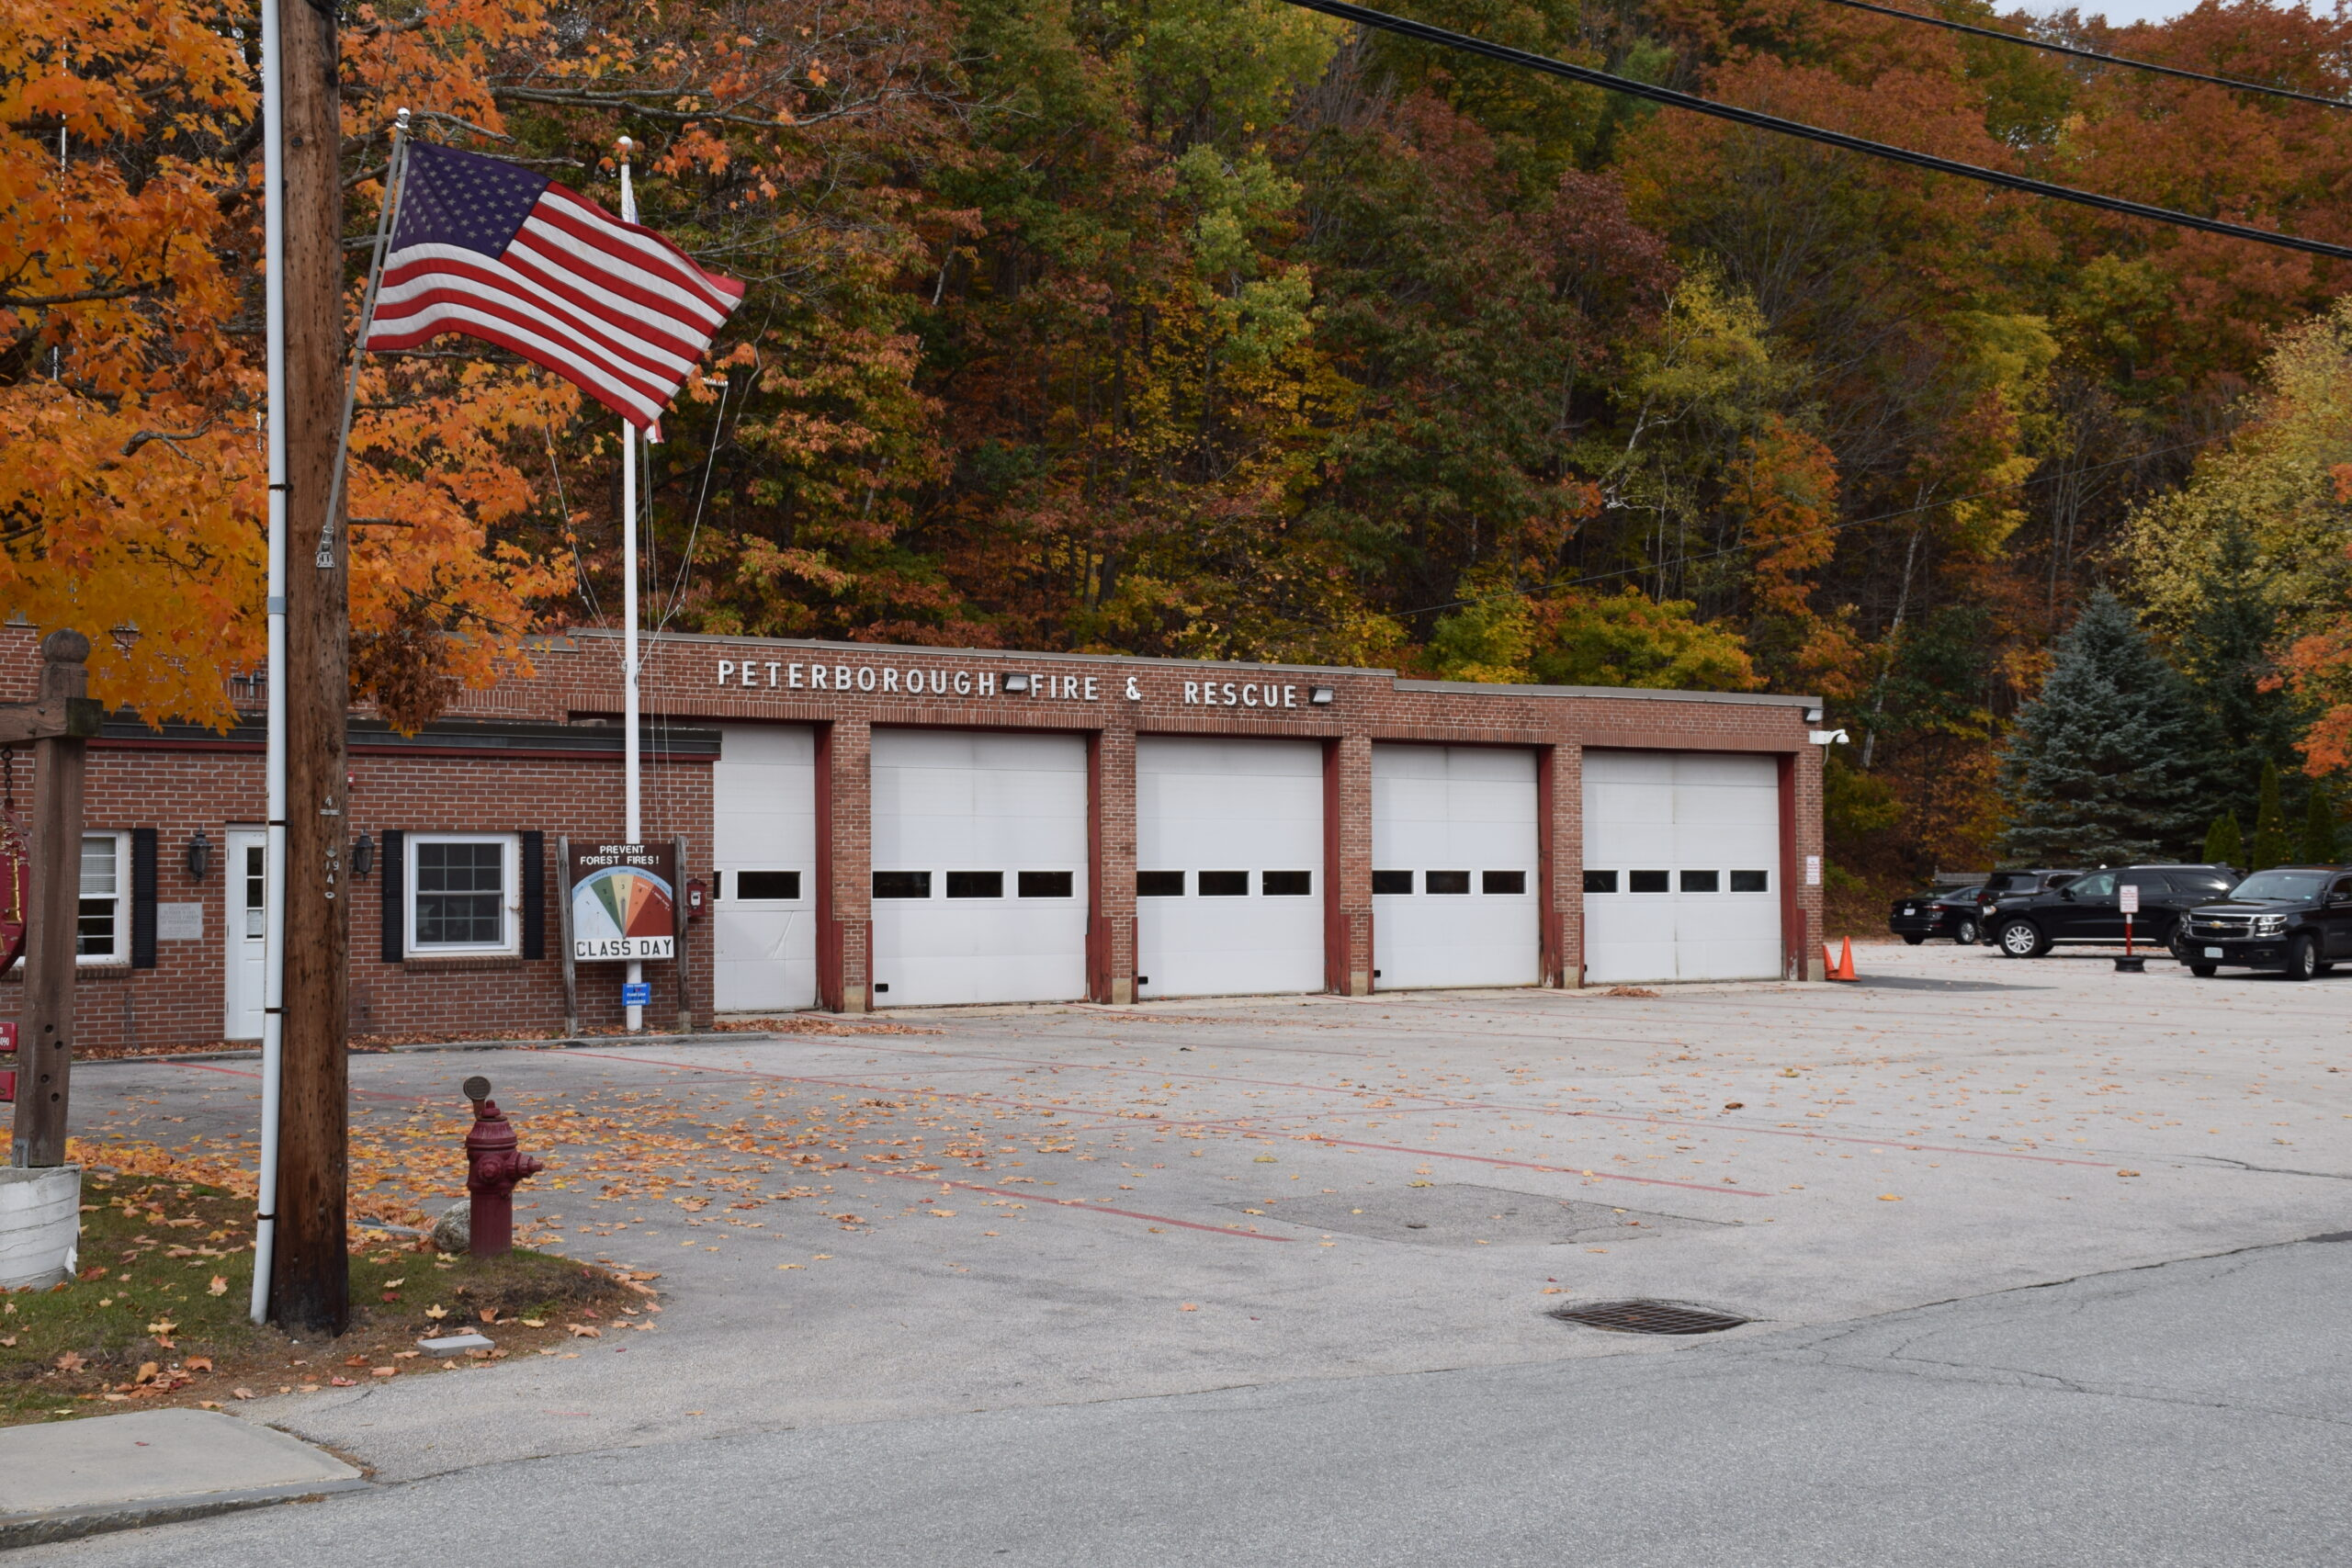
Fire Station Project
Update Dec. 2022

Slide 2
Acknowledgements 2021/2022
Architecture Selection Team 2021
Rodney Bartlett, Tim Herlihy, Ed Walker, Jon Hampson, Tom Humphrey, Peter Laroche, Ed Walker, Nicole MacStay
Municipal Task Force 2021
Roland Patten, Bill Kennedy, Alan Zeller, Kate Coon, Jon Hampson, Valerie Jenkins, Peter Laroche, Colin Murdough, Sarah Steinberg-Heller, Ed Walker, Rob Fox, Beth Alpaugh-Cote, Matt Lundsted, Danica Melone, Nicole MacStay
Select Board
Bill Taylor, Tyler Ward, Bill Kennedy
Budget Committee
Carl Mabbs-Zeno, Leslie Lewis, Mandy Sliver, Rick Lesser, Andrew Osterman, Ronnie McIntire, Mary Clark, Al Lenos
Fire Dept.
Ed Walker, Jon Hampson, Brad Winters
Other Town Staff
Lilli Gilligan
Tim Rose
Residents of Peterborough

Slide 3
Activities/Studies Leading up to 2021
Evans Flats Analysis, 2004
Weller and Michael - Municipal Facilities Assessment and Feasibility Study, 2005
Municipal Needs Study Task Force, 2006
Master Plan Steering Committee, 2008
Municipal Facilities Chapter 12, 2013
Warren Street Architects Preliminary Fire Station Program, 2017
HKT – Programmatic Study, Schematic Design, Site Survey, Cost Estimating, 2021
Visit: peterboroughprojects.info

Slide 4
Fire Station Project – Phase 2
Gather information to inform Peterborough’s project and process for project delivery
Report back to Select Board with recommendations
Balancing programmatic need with availability of funding
Understanding what the community is willing to invest
Project delivery methods
Learning from other communities that have built fire stations
Gather professional service resources
Evaluate alternatives, such as re-use of an existing fire station design
Seek out and utilize community input

Slide 5
Project Development Assumptions
The project scope is the development of a new facility designed to house the Fire and Ambulance Services, with some consideration to future community needs
The Select Board are the owners of this project. They will be provided with regular updates and will formally decide on all relevant considerations leading to public vote in May of 2024
Peterborough has committed to the development of a new fire station to be located on Elm St.
Future contracted service providers will be tasked with validating and/or revising the prior programmatic study
Programmatic information will be delivered in a meaningful and easy-to-understand format
The new station will be designed to accommodate that validated/revised program the Dept. currently delivers, with some consideration to future growth
The community expects a project that balances programmatic need with financial viability
The community expects a strong public process that solicits and utilizes community input

Slide 6
Summary of Activities May 2022 to present
May
Town Meeting authorizing $2m for design, engineering & construction of a new fire station
Meetings w/ Select Board members, Fire Chief, Town Administrator, Budget Committee members
June
Select Board workshop to discuss expectations and goals for the project
Additional meetings w/ stakeholders
July
Budget Committee / Finance informal meeting to establish goals for Aug. budget / CIP session
Additional meetings w/ stakeholders
August
Keene, Swanzey, Groton, and Westford tour (Bud Com)
Additional meetings w/ stakeholders
Budget Committee / CIP joint meeting to discuss debt-cap / bonding capacity for the project
September
Somersworth, Dover tours
Fire Design Symposium
October
Select Board provided 70% total bond capacity target for project
November
Select Board workshop
Newbury tour
Additional meetings w/ stakeholders

Slide 7
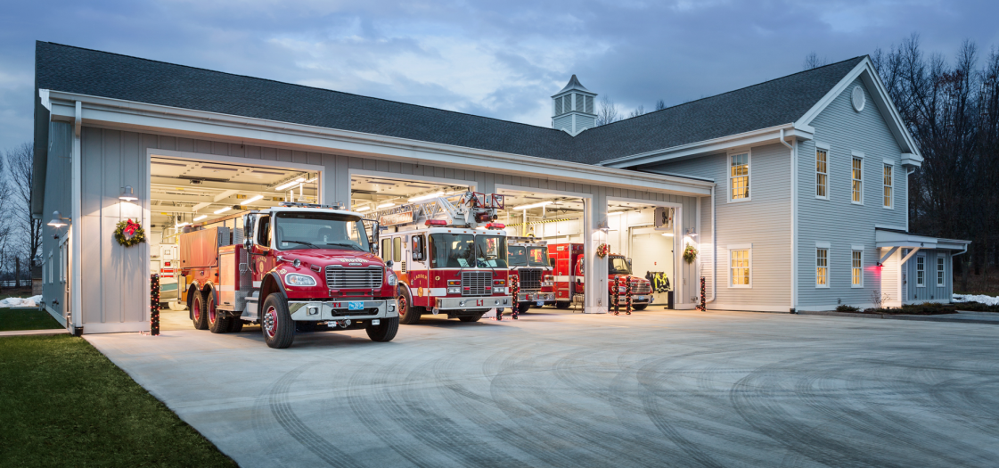
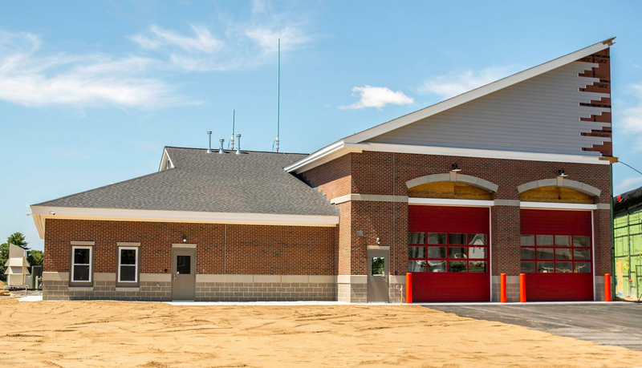
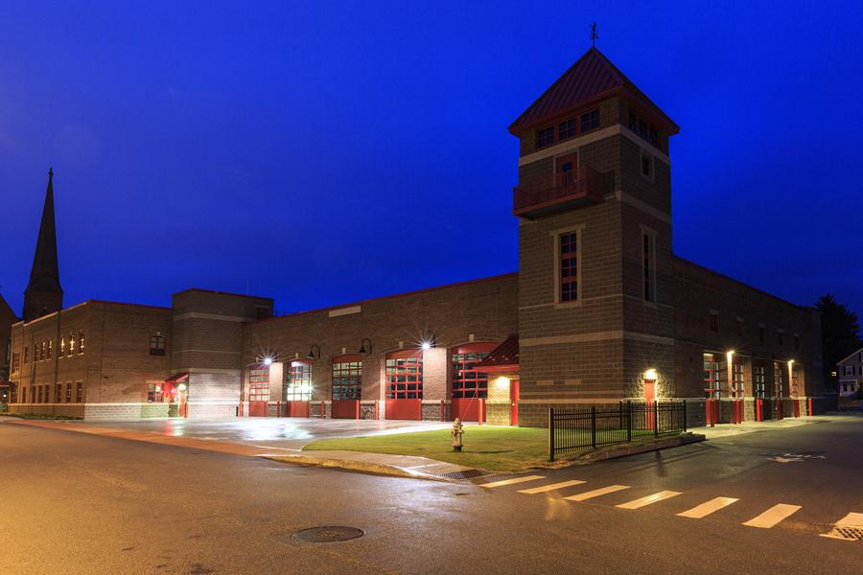
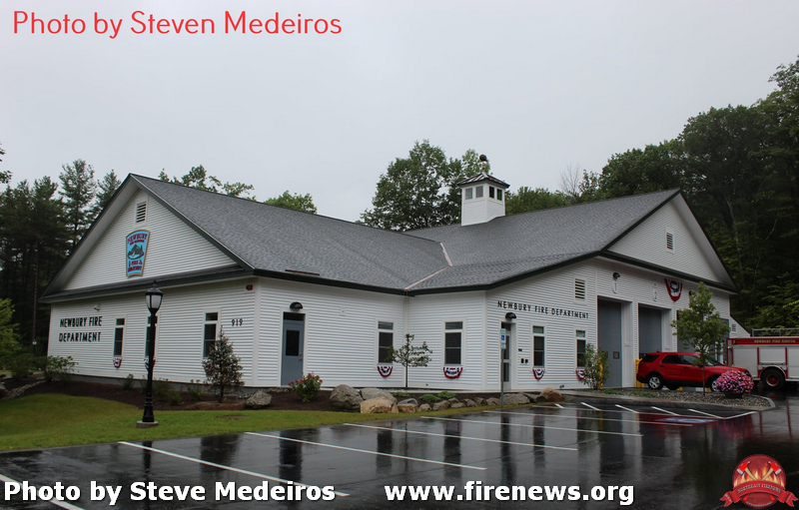
Facility Tours
Keene, Swanzey, Dover, Somersworth, Westford MA*, Groton MA, Newbury
Met with Fire Chiefs, City/Town Managers, and staff for Q&A and tour
Bud Com developed a great list of questions
Discussion on public process, design process
Obtained helpful RFQ and contract documents
Key takeaways:
No two projects were exactly alike, though some consistencies in design and process emerged
Projects ranged from $3 million to $11 million
2008 through 2022
Projects utilized strong owner representation
Size and scope varied greatly based on programmatic needs, community goals, availability of funding, type of government
Many design considerations Peterborough may be able to use
Avoidable design oversights
City Managers were ecstatic with the outcome, Fire staff resoundingly indicated additional space was needed ☺
Steering Committees ranged in size and scope depending on the community

Slide 8
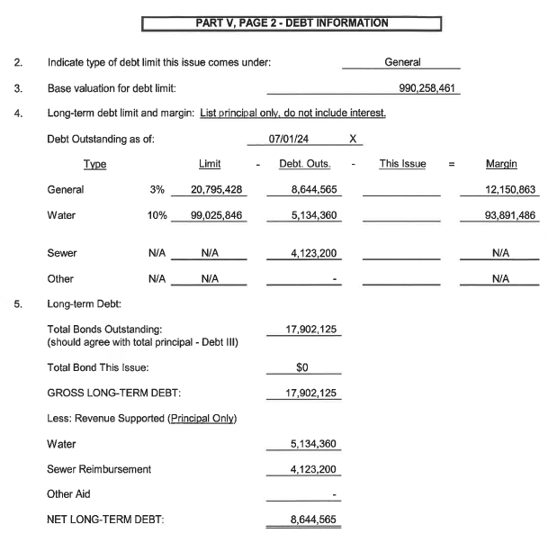
Bonding Capacity Meeting
Not to exceed 70% of total bond capacity
Projected FY25 $12,150,863.
This may necessitate a phased approach to construction in order to meet long-term programmatic goals

Slide 9
FIERO Design Symposium
Opportunity to network and learn from other communities and professional service providers
Covered topics such as:
Project programming
Project delivery systems
Emerging and existing technologies
Design
Apparatus bays
Kitchens
Fitness
Office spaces
Decontamination
Laundry
Humidity control
Community engagement & effective planning
Safety
Location analysis
Sound control
Decontamination
RFP/Q Process
Phased construction
Construction administration
USDA loan information
Storm shelters
Climate change
Construction pricing trends
Supply-chain issues

Slide 10
Project Delivery Methods: Design / Bid / Build
Design / Bid / Build
50% projects nationwide
10% in the northeast
Advantages
One bid package
Competitive bidding can sometimes result in lower pricing
Low cost at time of bid based on contractors' interpretation of plans/specs
Provides fair and equitable delivery system for contractors
Allows adequate control for project owner
Disadvantages
Change Orders
Limited opportunity for value engineering
Multiple points of contact during construction between owner/designer/contractor
Schedule determined by owner / architect
Three party conflict resolution (owner/designer/contractor)
Owner is mediator between architect and contractor
Owner assumes the most risk for the project (accuracy of drawing, managing numerous contracts)
Architect schedules sometimes do not align with contractors
Bids can be missed due to problematic construction estimates
Design constructability issues can arise requiring additional time and money to rectify

Slide 11
Project Delivery Methods: Design / Build
Design / Build
10% projects nationwide
Advantages
Fast delivery compared to traditional design-bid-build method
One point of contact between owner and contractor/designer
Designer has access to construction cost during the design phase
Owner has access to the project team
Quality control is enhanced with the designer and contractor communicating during design phase
Disadvantages
Tends to be the most expensive delivery method
Tends to not be utilized on expensive public projects
Less involvement from owner and public
Architect does not serve directly as owners' agent
Cost commitments often not based on full design set
Limited opportunity for value engineering

Slide 12
Project Delivery Methods: Construction Manager at Risk (CMAR)
CMAR
40% projects nationwide
90% of northeast projects
Advantages
Detailed cost transparency & regular cost estimating throughout project to meet budgetary targets and key dates
Key personnel continuity for the entire project
Design input and constructability collaboration between owner, designer, and construction manager
Minimizes change orders / allows for carrying lower contingencies
Aligns cost with scope prior to GMP
Mitigates risk for project owner
Increased project control for the community, particularly in design phases
Pre-construction Services: development of master schedule, early budget estimates, programmatic review, evaluation of alternatives, site analysis, and other considerations before defining scope for architectural services
Most likely delivery method to control cost and work to a prescribed budget
Disadvantages
Increased collaboration requires additional time, meetings, etc.
Quality control issues with the utilization of less skilled subs
Lower-quality materials can be used to keep cost down
Risk for communication errors since the construction manager is a single point of contact

Slide 13
Recommendation
Formation of RFQ Development and Selection Team for CM & Architecture Services
Community Input – total project value, questions regarding programming, community engagement
Select Board Direction – community engagement, total project value, evaluation of alternatives
Design & Construction Challenges – supply-chain, accurate scheduling, selecting the right architect and consultants, market volatility
Construction Management
Select first for pre-construction services and expert owner representation
Architecture
Select second

Slide 14
Recommendation Cont’d
CM Pre-Construction Services (select 1st)
Assist with defining preliminary program and establishing project goals
Prepare master schedule
Prepare regular cost estimates and help with regular value engineering
Evaluate alternatives
Design re-use
Phased construction
Evaluation of existing work including programmatic studies
Site analysis
Assist with architect/engineer selection
Assist with coordination of community engagement
Address constructability and scheduling issues early in the process
National construction pricing has increased 55-65% since 2009 depending on region
Since the pandemic, construction pricing has increased at a rate of 3% per quarter, 18% from Q1 to Q3 2021
Pricing has begun to level off since last year, but remains volatile
Architecture/Engineering (select 2nd)
Coordinate and execute community input strategy
Design development
Programming
Schematic design
Construction documents
Town meeting 2024
Construction

Slide 15
Professional Services RFQ and Selection Team
Establish goals and priorities for the community and expectations for professional service providers
Review, revise, and approve RFQ documents and scoring matrix for each phase
Perform in-person interviews with prospective service providers and score submissions
Recommend selection and contract awards to the Selectboard
Timeline
Dec. 22 - meet as-needed to develop RFQ documents and scoring matrix
Jan. 23 - “out to bid” for professional CM services & CM selection process
Feb. 23 - work with selection team and CM on development of RFQ for architectural services
March 23 – “out to bid” for architectural services & architect selection

Slide 16
RFQ Development / Selection Team - Recommendation
Bill Taylor, SB Project Liaison
Ed Walker, Fire Chief
Carl Mabbs-Zeno, Budget Committee
Tim Herlihy, Code Enforcement Officer
Sarah Steinberg-Heller, Planning Board
Tony Cassady, Energy Committee
Mandy Sliver, Treasurer / Budget Committee
Carol Nelson, EDA Subcommittee
Seth MacLean, Project Manager

Slide 17
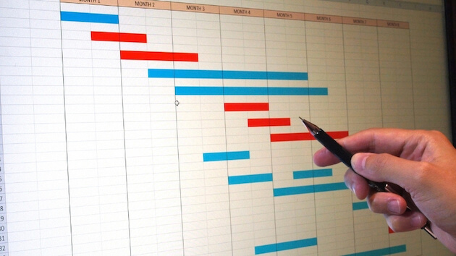
Tentative Project Schedule
Dec. 2022 to March 2023
Selection of professional service providers
March 2023 to Dec. 2023
Appointment of Steering Committee
Community engagement
In-person meetings, online, social media, surveys, office hours
Design development
Approved working / biddable construction documents
January 2024
Public budget process
May 2024
Town meeting vote
June 2024
Construction bidding period

Slide 18
Contact me!
Seth MacLean, Director DPW
Email: seth@peterboroughnh.gov
Phone: 603-924-8000 ex.102
Fire Station Project - Office Hours:
Wednesday afternoons 1pm-2pm, or as scheduled.

